Slide 1

Designing a Snowflake Schema Data Model
Nora Ayaz
Anna-Pauliina Pyykönen

Slide 2

About the Data
Olympics statistics, Winter and Summer
Columns:
Winter and Summer medal statistics have the same column structure:
Countries data has the Country name, code and general statistics about the country:

Slide 3
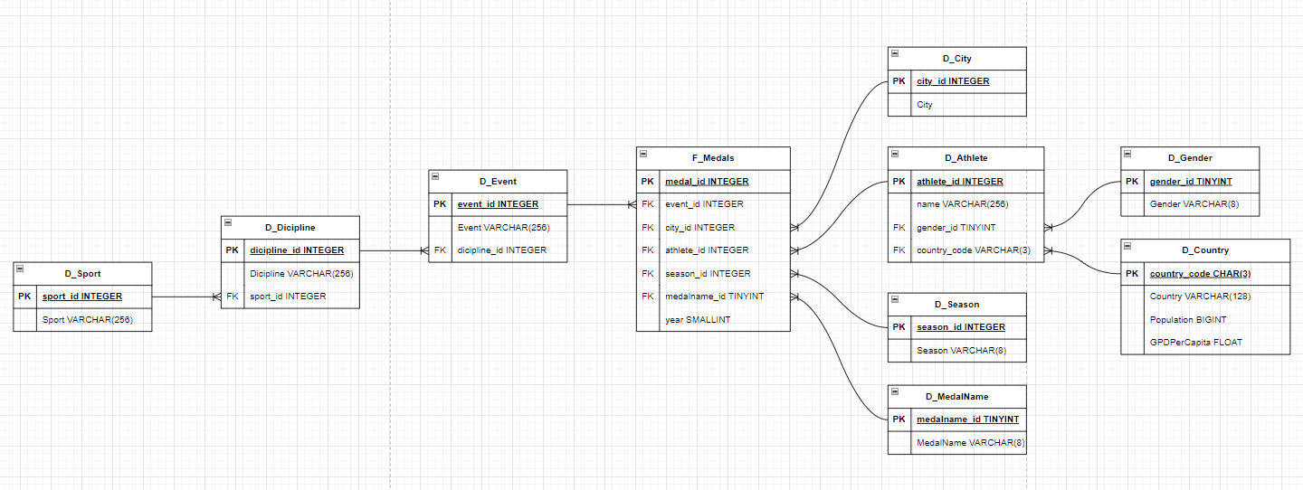
Snowflake model

Slide 4
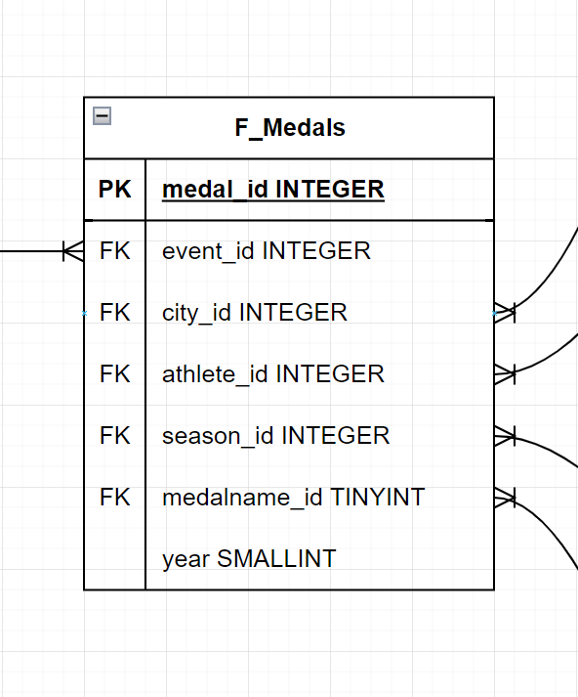
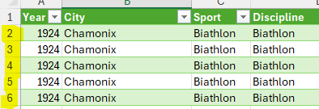
Fact Medals
Medal_id is the row number from the csv/excel.
Medal_name_id is a tinyint, because there are currently only 3 medals.
Year is left to the table as it is a small number, so it does not save space to make another table.

Slide 5
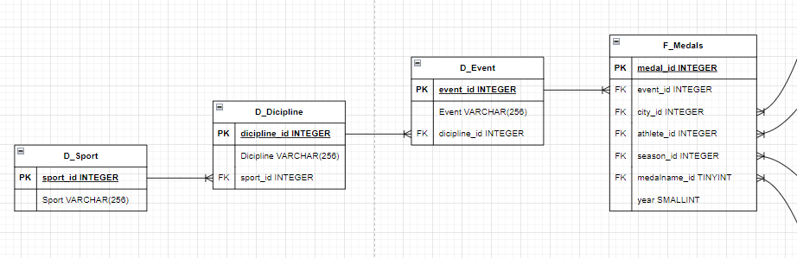
D_Event, D_Dicipline, D_Sport
The event, dicipline and and sport seem to make a hierarchy
Sport is the broadest category
Dicipline is more detailed than the Sport
And Event is the most detailed one
Medals are given for events

Slide 6
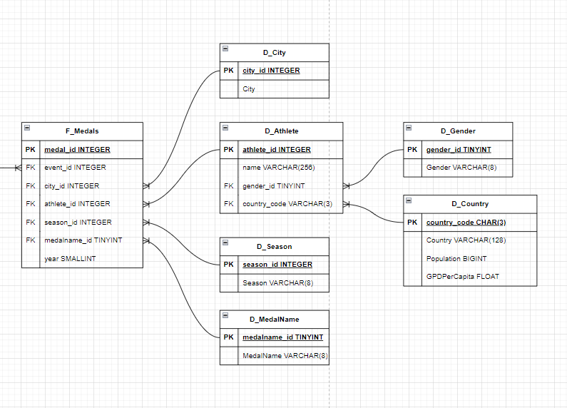
D_Athlete, D_Gender, D_Country, D_City, D_Country, D_Season, D_MedalName
The Season (Winter/Summer), City, MedalName are details about where an athlete got a medal
Gender and Country are related to the Athlete who got the medal
D_MedalName contains the text for the medal names: Gold, Silver and Bronze

Slide 7
Datatypes; F_Medals
medal_ID: We need to use int datatype for medal_ID. Because we will store around 40000 rows in medal_ID.
year_ID: It is enough to use smallint datatype for the year. Because our year data consists of 4-digit numbers.

Slide 8

Datatypes; D_Sport, D_Dicipline, D_Event
sport_ID: We just need to use tinyint datatype for sportID. Because we will store about 50 different types of sports in it.
discipline_ID: We just need to use tinyint datatype for disciplineID. Because we will store about 80 different types of disciplines in it.
event_ID: We just need to use smallint datatype for eventID. Because we will store about 750 different types of events in it.
sport_name: We need to use varchar(50) datatype for sportName. It is sufficient for the varchar datatype limit to be 50.
discipline_name: We need to use varchar(50) datatype for sportName. It is sufficient for the varchar datatype limit to be 50.
event_name: We need to use varchar(70) datatype for sportName. It is sufficient for the varchar datatype limit to be 70.

Slide 9
Datatypes; D_City ,D_Athlete
city_ID: We just need to use tinyint datatype for cityID. Because we will store about 40 different types of cities in cityID.
city_name: We need to use varchar(30) datatype for city_name. It is sufficient for the varchar datatype limit to be 30.
athlete_ID: We just need to use smallint datatype for athleteID. Because we will store about 27000 different types of athletes in it.
athlete_name: We need to use varchar(50) datatype for athlete_name. It is sufficient for the varchar datatype limit to be 50.
gender_ID: We need to use varchar(1) datatype for genderID. Our genderID data consists of single characters (F, M). It is sufficient for the varchar datatype limit to be 1.
country_ID: We need to use varchar(3) datatype for countryID. Our countryID data consists of three characters (HUN, AUT, GRE). It is sufficient for the varchar datatype limit to be 3.

Slide 10
Datatypes; D_Season, D_MedalName
season_ID: We need to use varchar(1) datatype for seasonID. Our season_ID data consists of single characters (W, S). It is sufficient for the varchar datatype limit to be 1.
medalName_ID: We need to use varchar(1) datatype for medalName_ID. Our medalName_ID data consists of single characters (G, S, B). It is sufficient for the varchar datatype limit to be 1.
season_name: We need to use varchar(6) datatype for season_name. It is sufficient for the varchar datatype limit to be 6 (winter, summer).
medalName: We need to use varchar(6) datatype for city_name. It is sufficient for the varchar datatype limit to be 6 (gold, silver, bronze).

Slide 11
Datatypes; D_Gender, D_Country
gender_ID: We need to use varchar(1) data type for genderID. Our genderID data consists of single characters (F, M). It is sufficient for the varchar datatype limit to be 1.
gender_name: We need to use varchar(6) datatype for gender_name. It is sufficient for the varchar datatype limit to be 6 (Female, Male).
country_ID: We need to use varchar(3) data type for countryID. Our countryID data consists of three characters (HUN, AUT, GRE). It is sufficient for the varchar datatype limit to be 3.
country_name: We need to use varchar(20) datatype for country_name. It is sufficient for the varchar datatype limit to be 20.
population: We need to use int datatype for country_name.
gdp_per_capita: Since it contains decimal data, we must use float datatype for gdp_per_capita.

